Slide 1
An Adventure
A game about a guy running around with a sword

Slide 2
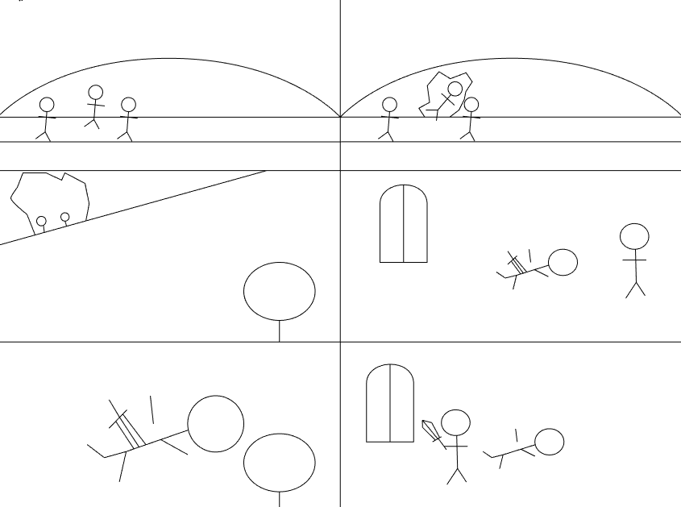
The story
The player is a warrior in training. He comes from a low standing background and spends his time practicing his sword skills and exploring with his friends.
One day while exploring some ruins in the forest he falls through the roof and finds himself in a small room. He yells up to his friends to let them know he's ok.
He finds a sword sticking out of a corpse and inspects it. It's a good sword, strangely in good condition for being embedded in a body for who knows how long.
This sword, will change his life. (no this is not excalibur, any old fool could have pulled it from the body)

Slide 3
The game
The player is a sword fighter. They also use a shield. Melee attacks and blocking are core features of the gameplay. Dodging will also be included.
They are also a leading figure in their group of friends, all of which are also fighters. They generally follow his lead when in combat. The player will have access to formation commands. Basic formations include:
Shield wall, buddy system, turtle.
Player can also pick up weapons lying on the floor and use them. Also throw them.

Slide 4
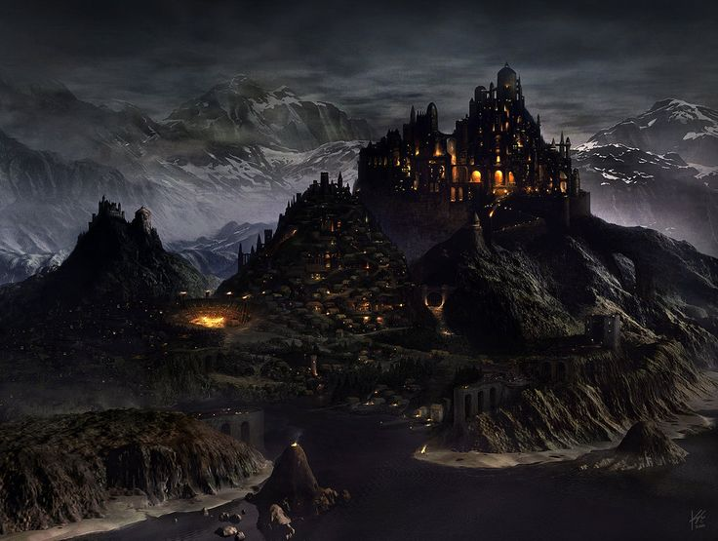
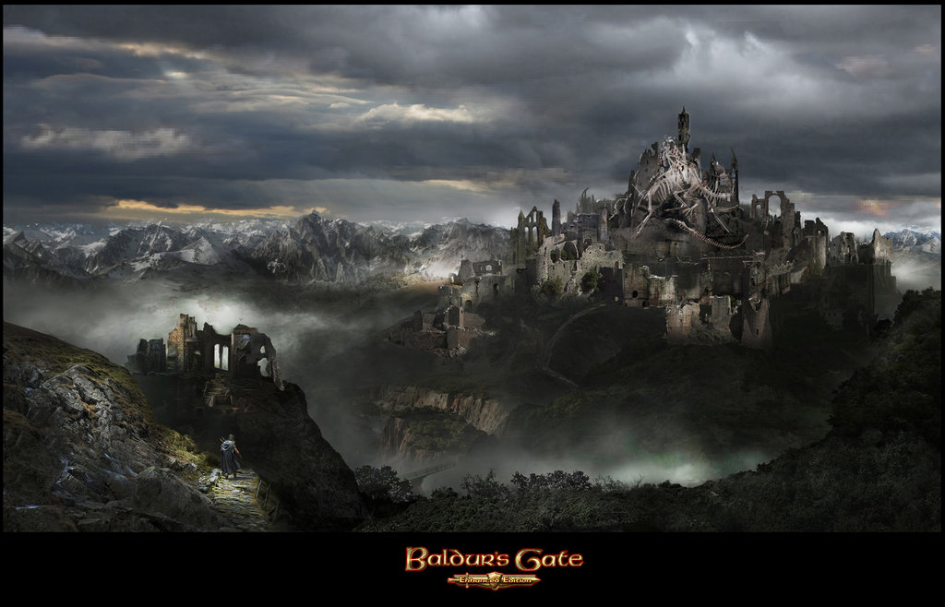
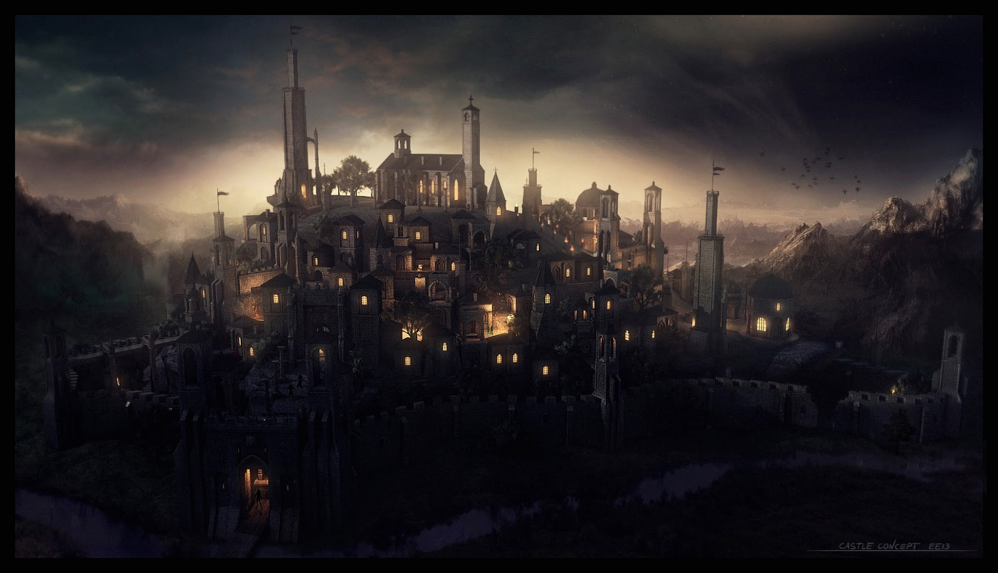
Art
The art style will be dark. Towns will be the sole light in a shadowy world, and even they are bleak. Cities that should be bastions of light, show no promise of supporting this image. The old ruins are active and full of the living dead, the shadow of these places spread as the number of dead grows.

Slide 5
Week 1
Week 2
Week 3
Have greybox landscape and buildings complete
Create state machines to tell AI how to behave and when
Create state machines for player actions, attack, block and pickup weapon.
Create AI that follows the states dictated by the state machine.
Player controls
Graphics and and world appearance.

Slide 6
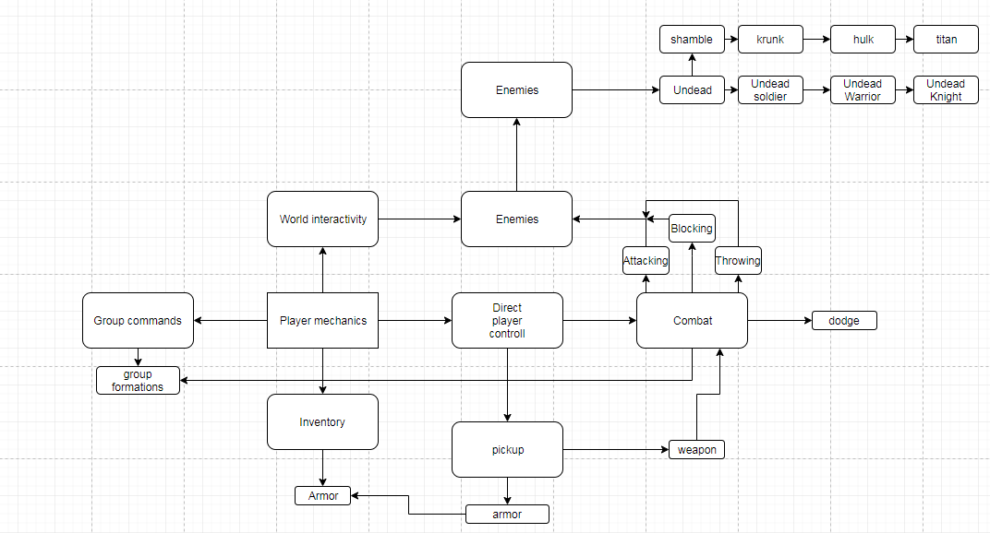
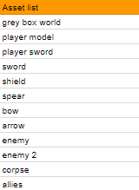
Asset list and mind map

Slide 7
Questions?

